Slide 1

Magic 8 Ball
Moutsaem Akkad
Krystal Briggs
Gan Jin
Jihan McKenzie
Denise Person
Rachel Song

Slide 2
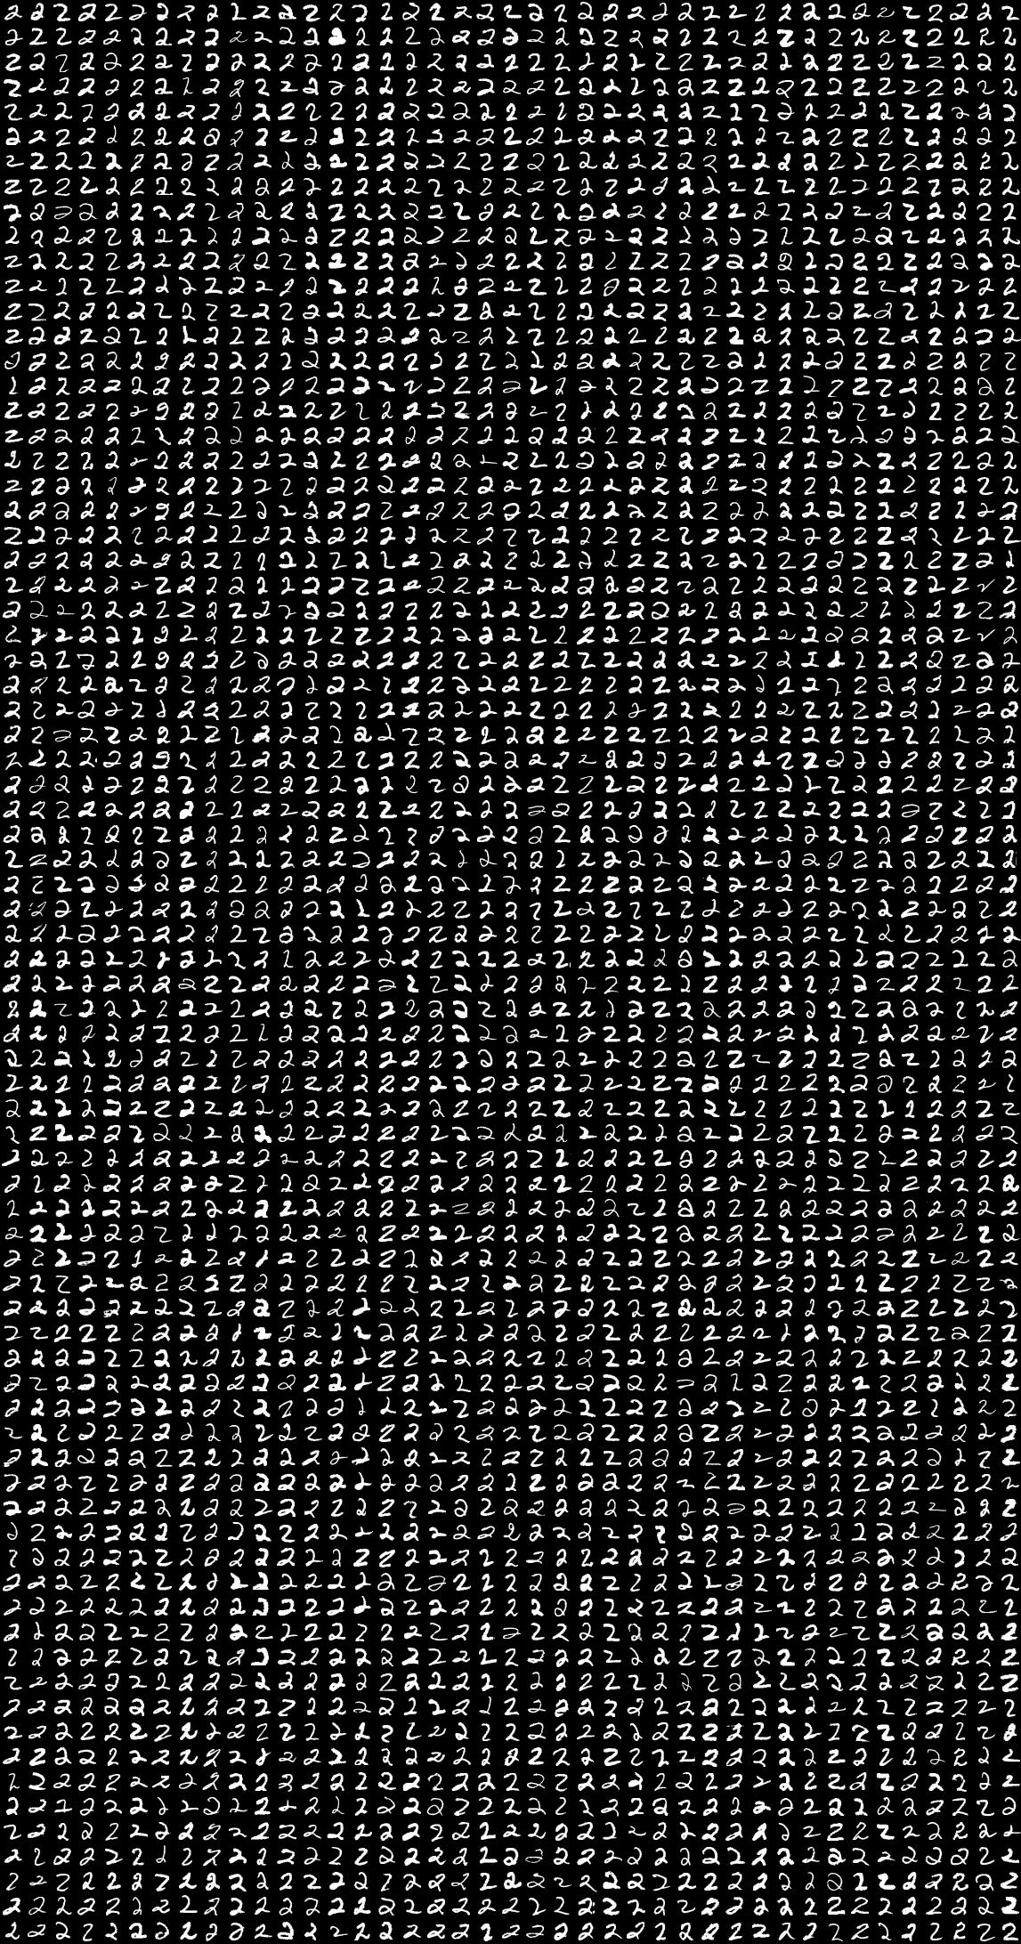
Project Proposal:
Create a user interactive interface that utilizes machine learning to identify handwritten numbers

Slide 3

DATA
Tools:
Keras for Neural Network
HTML, CSS, Bootstrap to create webpage
Javascript
Flask server
S3
Google API

Slide 4
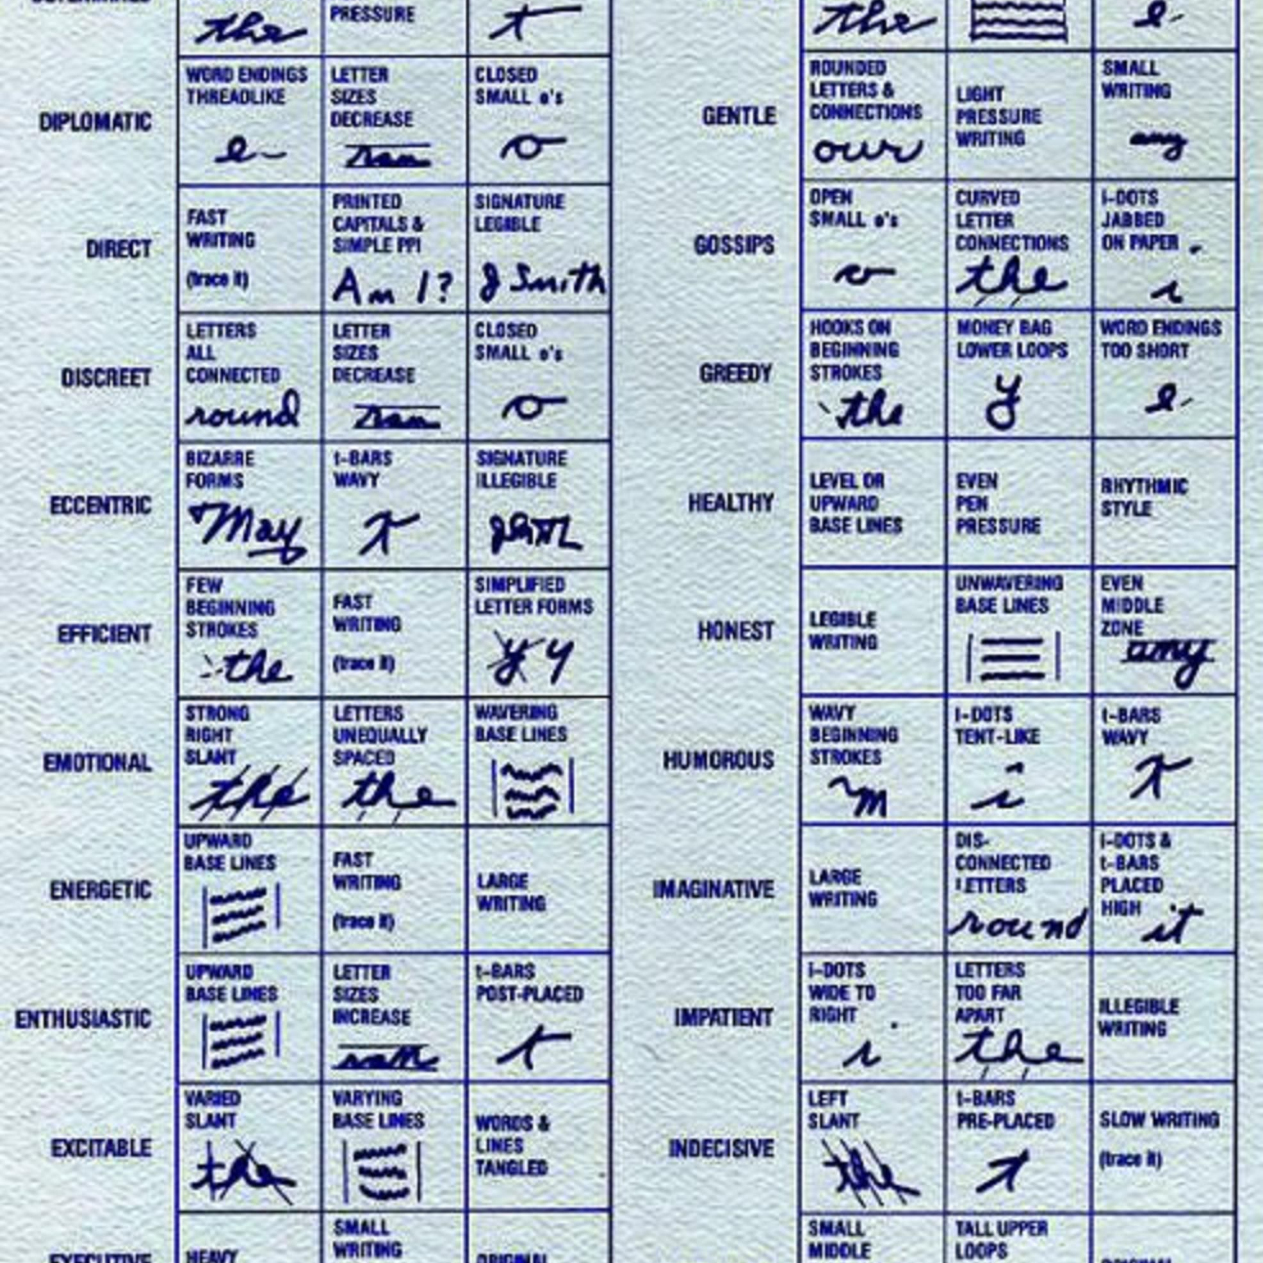
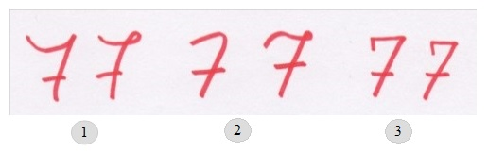
Graphology
“Graphology is the analysis of the physical characteristics and patterns of handwriting claiming to be able to identify the writer, indicating the psychological state at the time of writing, or evaluating personality characteristics. It is generally considered a pseudoscience.”
https://en.wikipedia.org/wiki/Graphology

Slide 5
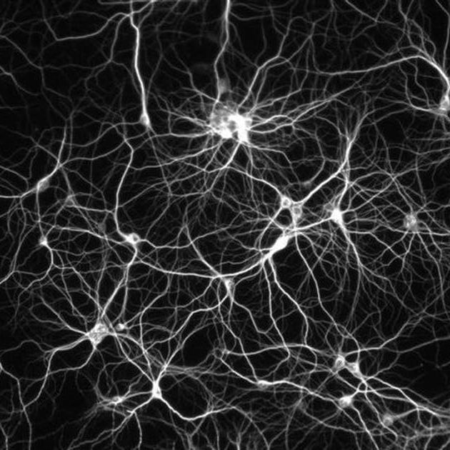
Neural Network
Powerful method of computing
Ability to learn from experience and improve performance
Deal with incomplete information
Notes:
Neural Network
- Go over with Moutasem on Wednesday

Slide 6
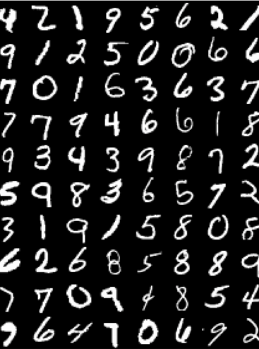
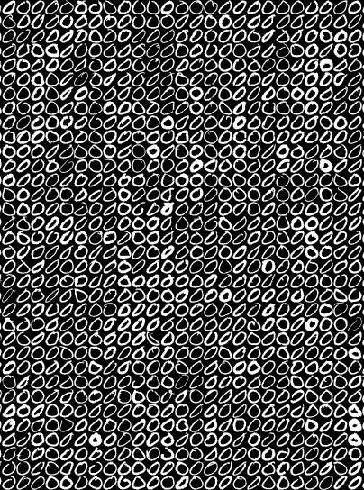
Dataset
Data is extracted from the Modified National Institute of Standards and Technology (MNIST) Database.
The datasets contains handwritten digits and letters that are used to train image processing systems
Dataset contains:
Digits (http://yann.lecun.com/exdb/mnist/)
Alphabet (https://www.kaggle.com/sachinpatel21/az-handwritten-alphabets-in-csv-format)
Greyscale images (28x28 pixels)
MNIST
Notes:
Digits dataset
Created by Yann Lecun (NYU Prof)

Slide 7
Web Page
User interactive driven input onto canvas
User submits input
Flask
Prediction
Load image into model prediction
In Flask, convert back into image
Convert image back to pixels
Return prediction to web page
Javascript
Convert image to base 64 in Javascript
Create connection to Flask to predict endpoint
Project Steps

Slide 8
Coding / Live Demonstration

Slide 9
Challenges / Improvements
Webpage/HTML:
Formatting texts in the correct positions (appropriately linking to Flask and Javascript files)
Flask:
Returning results
Coding:
Pre-process steps to combine two datasets (original dataset already included)
Notes:
when we combined datasets into one dataframe (pre-process); separate features (X) from output (y); convert two matrixes and split to training/testing data; reshape vectors to feed to NN → ALL OF THIS was provided in the original dataset, but in order to make it to work we had to use raw data and combine everything together

Slide 10
Resources
Dataset:
http://yann.lecun.com/exdb/mnist/
https://www.kaggle.com/sachinpatel21/az-handwritten-alphabets-in-csv-format
PowerPoint template:
https://powerpointify.com/hipster-free-powerpoint-template/

Slide 11
Thank you
Questions?

